Slide 1
JAVA BOOTCAMP DAY 02
Presented by
G2Academy

Slide 2
Object-Oriented Programming
Notes:
How presentation will benefit audience: Adult learners are more interested in a subject if they know how or why it is important to them.
Presenter’s level of expertise in the subject: Briefly state your credentials in this area, or explain why participants should listen to you.

Slide 3
What Is an Object?
Objects are key to understanding object-oriented technology. Look around right now and you'll find many examples of real-world objects: your dog, your desk, your television set, your bicycle.
Real-world objects share two characteristics: They all have state and behavior. Dogs have state (name, color, breed, hungry) and behavior (barking, fetching, wagging tail). Bicycles also have state (current gear, current pedal cadence, current speed) and behavior (changing gear, changing pedal cadence, applying brakes). Identifying the state and behavior for real-world objects is a great way to begin thinking in terms of object-oriented programming.
Notes:
Lesson descriptions should be brief.

Slide 4
What Is an Object?
Take a minute right now to observe the real-world objects that are in your immediate area. For each object that you see, ask yourself two questions:
"What possible states can this object be in?"
"What possible behavior can this object perform?“
As you do, you'll notice that real-world objects vary in complexity; your desktop lamp may have only two possible states (on and off) and two possible behaviors (turn on, turn off), but your desktop radio might have additional states (on, off, current volume, current station) and behavior (turn on, turn off, increase volume, decrease volume, seek, scan, and tune).
Notes:
Lesson descriptions should be brief.

Slide 5
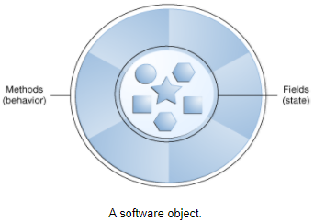
What Is an Object?
You may also notice that some objects, in turn, will also contain other objects. These real-world observations all translate into the world of object-oriented programming.
Notes:
Lesson descriptions should be brief.

Slide 6
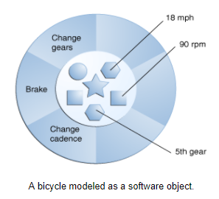
What Is an Object?
Software objects are conceptually similar to real-world objects: they too consist of state and related behavior. An object stores its state in fields (variables in some programming languages) and exposes its behavior through methods (functions in some programming languages). Methods operate on an object's internal state and serve as the primary mechanism for object-to-object communication. Hiding internal state and requiring all interaction to be performed through an object's methods is known as data encapsulation — a fundamental principle of object-oriented programming.
Notes:
Lesson descriptions should be brief.

Slide 7
What Is an Object?
By attributing state (current speed, current pedal cadence, and current gear) and providing methods for changing that state, the object remains in control of how the outside world is allowed to use it. For example, if the bicycle only has 6 gears, a method to change gears could reject any value that is less than 1 or greater than 6.
Notes:
Lesson descriptions should be brief.

Slide 8
What Is an Object?
Bundling code into individual software objects provides a number of benefits, including:
Modularity: The source code for an object can be written and maintained independently of the source code for other objects. Once created, an object can be easily passed around inside the system.
Information-hiding: By interacting only with an object's methods, the details of its internal implementation remain hidden from the outside world.
Code re-use: If an object already exists (perhaps written by another software developer), you can use that object in your program. This allows specialists to implement/test/debug complex, task-specific objects, which you can then trust to run in your own code.
Pluggability and debugging ease: If a particular object turns out to be problematic, you can simply remove it from your application and plug in a different object as its replacement. This is analogous to fixing mechanical problems in the real world. If a bolt breaks, you replace it, not the entire machine.
Notes:
Lesson descriptions should be brief.

Slide 9
What Is a Class?
In the real world, you'll often find many individual objects all of the same kind. There may be thousands of other bicycles in existence, all of the same make and model. Each bicycle was built from the same set of blueprints and therefore contains the same components. In object-oriented terms, we say that your bicycle is an instance of the class of objects known as bicycles. A class is the blueprint from which individual objects are created.
Notes:
Lesson descriptions should be brief.

Slide 10
What Is a Class?
The following Bicycle class is one possible implementation of a bicycle:
class Bicycle {
int cadence = 0;
int speed = 0;
int gear = 1;
void changeCadence(int newValue) {
cadence = newValue;
}
void changeGear(int newValue) {
gear = newValue;
}
void speedUp(int increment) {
speed = speed + increment;
}
void applyBrakes(int decrement) {
speed = speed - decrement;
}
void printStates() {
System.out.println("cadence:" +
cadence + " speed:" +
speed + " gear:" + gear);
}
}
Notes:
Lesson descriptions should be brief.

Slide 11
What Is a Class?
The syntax of the Java programming language will look new to you, but the design of this class is based on the previous discussion of bicycle objects. The fields cadence, speed, and gear represent the object's state, and the methods (changeCadence, changeGear, speedUp etc.) define its interaction with the outside world.
You may have noticed that the Bicycle class does not contain a main method. That's because it's not a complete application; it's just the blueprint for bicycles that might be used in an application. The responsibility of creating and using new Bicycle objects belongs to some other class in your application.
Notes:
Lesson descriptions should be brief.

Slide 12
What Is a Class?
Here's a BicycleDemo class that creates two separate Bicycle objects and invokes their methods:
class BicycleDemo {
public static void main(String[] args) {
// Create two different
// Bicycle objects
Bicycle bike1 = new Bicycle();
Bicycle bike2 = new Bicycle();
// Invoke methods on
// those objects
bike1.changeCadence(50);
bike1.speedUp(10);
bike1.changeGear(2);
bike1.printStates();
bike2.changeCadence(50);
bike2.speedUp(10);
bike2.changeGear(2);
bike2.changeCadence(40);
bike2.speedUp(10);
bike2.changeGear(3);
bike2.printStates();
}
}
Notes:
Lesson descriptions should be brief.

Slide 13
What Is a Class?
The output of the test prints the ending pedal cadence, speed, and gear for the two bicycles:
cadence:50 speed:10 gear:2
cadence:40 speed:20 gear:3
Notes:
Lesson descriptions should be brief.

Slide 14
Classes and Objects
Notes:
How presentation will benefit audience: Adult learners are more interested in a subject if they know how or why it is important to them.
Presenter’s level of expertise in the subject: Briefly state your credentials in this area, or explain why participants should listen to you.

Slide 15
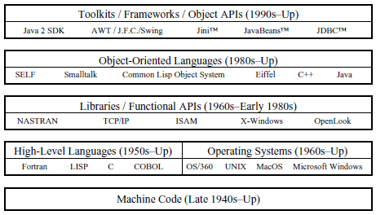
Software Engineering
Notes:
How presentation will benefit audience: Adult learners are more interested in a subject if they know how or why it is important to them.
Presenter’s level of expertise in the subject: Briefly state your credentials in this area, or explain why participants should listen to you.

Slide 16
The Analysis and Design Phase
Analysis describes what the system needs to do:
Modeling the real-world, including actors and activities, objects, and behaviors
Design describes how the system does it:
Modeling the relationships and interactions between objects and actors in the system
Finding useful abstractions to help simplify the problem or solution
Notes:
How presentation will benefit audience: Adult learners are more interested in a subject if they know how or why it is important to them.
Presenter’s level of expertise in the subject: Briefly state your credentials in this area, or explain why participants should listen to you.

Slide 17
Abstraction
Functions – Write an algorithm once to be used in many situations
Objects – Group a related set of attributes and behaviors into a class
Frameworks and APIs – Large groups of objects that support a complex activity; Frameworks can be used as is or be modified to extend the basic behavior
Notes:
How presentation will benefit audience: Adult learners are more interested in a subject if they know how or why it is important to them.
Presenter’s level of expertise in the subject: Briefly state your credentials in this area, or explain why participants should listen to you.

Slide 18
Classes as Blueprints for Objects
In manufacturing, a blueprint describes a device from which many physical devices are constructed.
In software, a class is a description of an object:
A class describes the data that each object includes.
A class describes the behaviors that each object exhibits.
In Java technology, classes support three key features of object-oriented programming (OOP):
Encapsulation
Inheritance
Polymorphism
Notes:
How presentation will benefit audience: Adult learners are more interested in a subject if they know how or why it is important to them.
Presenter’s level of expertise in the subject: Briefly state your credentials in this area, or explain why participants should listen to you.

Slide 19
Declaring Java Technology Classes
Basic syntax of a Java class:
<modifier>* class <class_name> {
<attribute_declaration>*
<constructor_declaration>*
<method_declaration>*
}
Example:
1 public class Vehicle {
2 private double maxLoad;
3 public void setMaxLoad(double value) {
4 maxLoad = value;
5 }
6 }
Notes:
How presentation will benefit audience: Adult learners are more interested in a subject if they know how or why it is important to them.
Presenter’s level of expertise in the subject: Briefly state your credentials in this area, or explain why participants should listen to you.

Slide 20
Declaring Attributes
Basic syntax of an attribute:
<modifier>* <type> <name> [ = <initial_value>];
Example:
1 public class Foo {
2 private int x;
3 private float y = 10000.0F;
4 private String name = "Bates Motel";
5 }
Notes:
How presentation will benefit audience: Adult learners are more interested in a subject if they know how or why it is important to them.
Presenter’s level of expertise in the subject: Briefly state your credentials in this area, or explain why participants should listen to you.

Slide 21
Declaring Methods
Basic syntax of a method:
<modifier>* <return_type> <name> ( <argument>* ) {
<statement>*
}
Example:
1 public class Dog {
2 private int weight;
3 public int getWeight() {
4 return weight;
5 }
6 public void setWeight(int newWeight) {
7 if ( newWeight > 0 ) {
8 weight = newWeight;
9 }
10 }
11 }
Notes:
How presentation will benefit audience: Adult learners are more interested in a subject if they know how or why it is important to them.
Presenter’s level of expertise in the subject: Briefly state your credentials in this area, or explain why participants should listen to you.

Slide 22
Accessing Object Members
The dot notation is: <object>.<member>
This is used to access object members, including attributes and methods.
Examples of dot notation are:
Dog d = new Dog();
d.setWeight(42);
d.weight = 42; // only permissible if weight is public
Notes:
How presentation will benefit audience: Adult learners are more interested in a subject if they know how or why it is important to them.
Presenter’s level of expertise in the subject: Briefly state your credentials in this area, or explain why participants should listen to you.

Slide 23
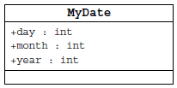
Information Hiding
The problem:
Client code has direct access to internal data (d refers to a MyDate object):
d.day = 32;
// invalid day
d.month = 2; d.day = 30;
// plausible but wrong
d.day = d.day + 1;
// no check for wrap around
Notes:
How presentation will benefit audience: Adult learners are more interested in a subject if they know how or why it is important to them.
Presenter’s level of expertise in the subject: Briefly state your credentials in this area, or explain why participants should listen to you.

Slide 24
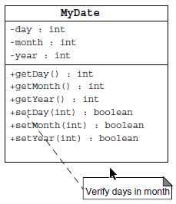
Information Hiding
The solution:
Client code must use setters and getters to access internal data:
MyDate d = new MyDate();
d.setDay(32);
// invalid day, returns false
d.setMonth(2);
d.setDay(30);
// plausible but wrong,
// setDay returns false
d.setDay(d.getDay() + 1);
// this will return false if wrap around
// needs to occur
Notes:
How presentation will benefit audience: Adult learners are more interested in a subject if they know how or why it is important to them.
Presenter’s level of expertise in the subject: Briefly state your credentials in this area, or explain why participants should listen to you.

Slide 25
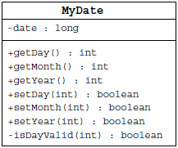
Encapsulation
Hides the implementation details of a class
Forces the user to use an interface to access data
Makes the code more maintainable
Notes:
How presentation will benefit audience: Adult learners are more interested in a subject if they know how or why it is important to them.
Presenter’s level of expertise in the subject: Briefly state your credentials in this area, or explain why participants should listen to you.

Slide 26
Declaring Constructors
Basic syntax of a constructor:
[<modifier>] <class_name> ( <argument>* ) {
<statement>*
}
Example:
1 public class Dog {
2
3 private int weight;
4
5 public Dog() {
6 weight = 42;
7 }
8 }
Notes:
How presentation will benefit audience: Adult learners are more interested in a subject if they know how or why it is important to them.
Presenter’s level of expertise in the subject: Briefly state your credentials in this area, or explain why participants should listen to you.

Slide 27
The Default Constructor
There is always at least one constructor in every class.
If the writer does not supply any constructors, the default constructor is present automatically:
The default constructor takes no arguments
The default constructor body is empty
The default enables you to create object instances with new Xxx()without having to write a constructor.
Notes:
How presentation will benefit audience: Adult learners are more interested in a subject if they know how or why it is important to them.
Presenter’s level of expertise in the subject: Briefly state your credentials in this area, or explain why participants should listen to you.

Slide 28
Source File Layout
Basic syntax of a Java source file is:
[<package_declaration>]
<import_declaration>*
<class_declaration>+
For example, the VehicleCapacityReport.java file is:
1 package shipping.reports;
2
3 import shipping.domain.*;
4 import java.util.List;
5 import java.io.*;
6
7 public class VehicleCapacityReport {
8 private List vehicles;
9 public void generateReport(Writer output) {...}
10 }
Notes:
How presentation will benefit audience: Adult learners are more interested in a subject if they know how or why it is important to them.
Presenter’s level of expertise in the subject: Briefly state your credentials in this area, or explain why participants should listen to you.

Slide 29
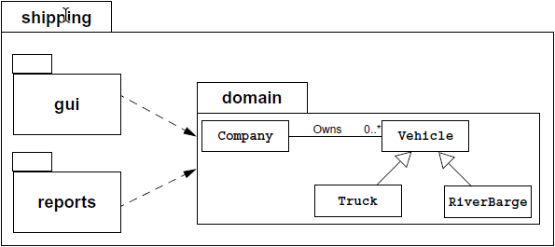
Software Packages
Packages help manage large software systems.
Packages can contain classes and sub-packages.
Notes:
How presentation will benefit audience: Adult learners are more interested in a subject if they know how or why it is important to them.
Presenter’s level of expertise in the subject: Briefly state your credentials in this area, or explain why participants should listen to you.

Slide 30
The package Statement
Basic syntax of the package statement is:
package <top_pkg_name>[.<sub_pkg_name>]*;
Examples of the statement are:
package shipping.gui.reportscreens;
Specify the package declaration at the beginning of the source file.
Only one package declaration per source file.
If no package is declared, then the class is placed into the default package.
Package names must be hierarchical and separated by dots.
Notes:
How presentation will benefit audience: Adult learners are more interested in a subject if they know how or why it is important to them.
Presenter’s level of expertise in the subject: Briefly state your credentials in this area, or explain why participants should listen to you.

Slide 31
The import Statement
Basic syntax of the import statement is:
import <pkg_name>[.<sub_pkg_name>]*.<class_name>;
OR
import <pkg_name>[.<sub_pkg_name>]*.*;
Examples of the statement are:
import java.util.List;
import java.io.*;
import shipping.gui.reportscreens.*;
The import statement does the following:
Precedes all class declarations
Tells the compiler where to find classes
Notes:
How presentation will benefit audience: Adult learners are more interested in a subject if they know how or why it is important to them.
Presenter’s level of expertise in the subject: Briefly state your credentials in this area, or explain why participants should listen to you.

Slide 32
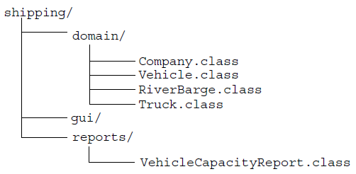
Directory Layout and Packages
Packages are stored in the directory tree containing the package name.
An example is the shipping application packages.
Notes:
How presentation will benefit audience: Adult learners are more interested in a subject if they know how or why it is important to them.
Presenter’s level of expertise in the subject: Briefly state your credentials in this area, or explain why participants should listen to you.

Slide 33
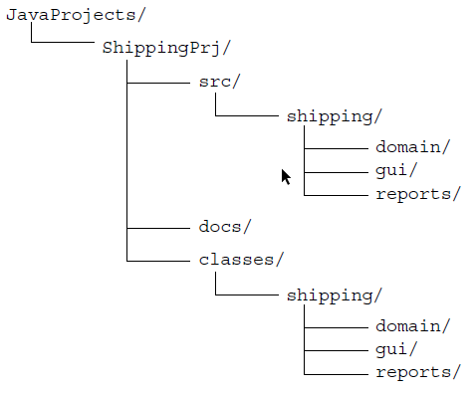
Development
Notes:
How presentation will benefit audience: Adult learners are more interested in a subject if they know how or why it is important to them.
Presenter’s level of expertise in the subject: Briefly state your credentials in this area, or explain why participants should listen to you.

Slide 34
Introduction to Java Applications
Notes:
How presentation will benefit audience: Adult learners are more interested in a subject if they know how or why it is important to them.
Presenter’s level of expertise in the subject: Briefly state your credentials in this area, or explain why participants should listen to you.

Slide 35
What Is the Java™ Technology?
Java technology is:
A programming language
A development environment
An application environment
A deployment environment
It is similar in syntax to C++.
It is used for developing both applets and applications.
Notes:
Example objectives
At the end of this lesson, you will be able to:
Save files to the team Web server.
Move files to different locations on the team Web server.
Share files on the team Web server.

Slide 36
Primary Goals of the Java Technology
Provides an easy-to-use language by:
Avoiding many pitfalls of other languages
Being object-oriented
Enabling users to create streamlined and clear code
Provides an interpreted environment for:
Improved speed of development
Code portability
Notes:
Example objectives
At the end of this lesson, you will be able to:
Save files to the team Web server.
Move files to different locations on the team Web server.
Share files on the team Web server.

Slide 37
Primary Goals of the Java Technology
Enables users to run more than one thread of activity
Loads classes dynamically; that is, at the time they are actually needed
Supports changing programs dynamically during runtime by loading classes from disparate sources
Furnishes better security
Notes:
Example objectives
At the end of this lesson, you will be able to:
Save files to the team Web server.
Move files to different locations on the team Web server.
Share files on the team Web server.

Slide 38
Primary Goals of the Java Technology
The following features fulfill these goals:
The Java Virtual Machine (JVM™)1
Garbage collection
The Java Runtime Environment (JRE)
JVM tool interface
Notes:
Example objectives
At the end of this lesson, you will be able to:
Save files to the team Web server.
Move files to different locations on the team Web server.
Share files on the team Web server.

Slide 39
Java Virtual Machine
Notes:
How presentation will benefit audience: Adult learners are more interested in a subject if they know how or why it is important to them.
Presenter’s level of expertise in the subject: Briefly state your credentials in this area, or explain why participants should listen to you.

Slide 40
The Java Virtual Machine
Provides hardware platform specifications
Reads compiled byte codes that are platform-independent
Is implemented as software or hardware
Is implemented in a Java technology development tool or a Web browser
Notes:
Example objectives
At the end of this lesson, you will be able to:
Save files to the team Web server.
Move files to different locations on the team Web server.
Share files on the team Web server.

Slide 41
Garbage Collection
Allocated memory that is no longer needed should be deallocated.
In other languages, deallocation is the programmer’s responsibility.
The Java programming language provides a system-level thread to track memory allocation.
Garbage collection has the following characteristics:
Checks for and frees memory no longer needed
Is done automatically
Can vary dramatically across JVM implementations
Notes:
Example objectives
At the end of this lesson, you will be able to:
Save files to the team Web server.
Move files to different locations on the team Web server.
Share files on the team Web server.

Slide 42
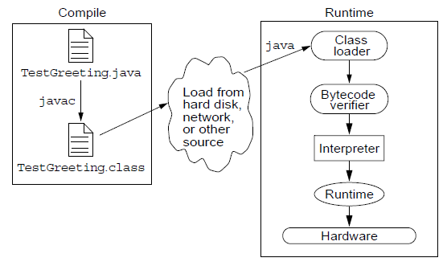
The Java Runtime Environment
The Java application environment performs as follows:
Notes:
Example objectives
At the end of this lesson, you will be able to:
Save files to the team Web server.
Move files to different locations on the team Web server.
Share files on the team Web server.

Slide 43
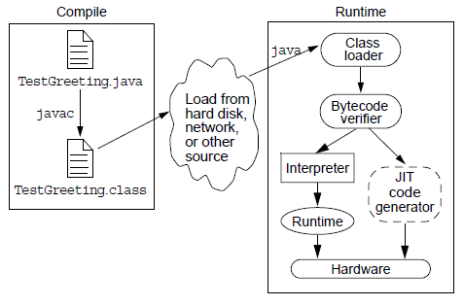
The Java Runtime Environment
Operation of the JRE With a Just-In-Time (JIT) Compiler
Notes:
Example objectives
At the end of this lesson, you will be able to:
Save files to the team Web server.
Move files to different locations on the team Web server.
Share files on the team Web server.

Slide 44
JVM™ Tasks
The JVM performs three main tasks:
Loads code
Vérifies code
Exécutes code
Notes:
Example objectives
At the end of this lesson, you will be able to:
Save files to the team Web server.
Move files to different locations on the team Web server.
Share files on the team Web server.

Slide 45
The Class Loader
Loads all classes necessary for the execution of a program
Maintains classes of the local file system in separate namespaces
Prevents spoofing
Notes:
Example objectives
At the end of this lesson, you will be able to:
Save files to the team Web server.
Move files to different locations on the team Web server.
Share files on the team Web server.

Slide 46
The Bytecode Verifier
Ensures that:
The code adheres to the JVM specification.
The code does not violate system integrity.
The code causes no operand stack overflows or underflows.
The parameter types for all operational code are correct.
No illegal data conversions (the conversion of integers to pointers) have occurred.
Notes:
Example objectives
At the end of this lesson, you will be able to:
Save files to the team Web server.
Move files to different locations on the team Web server.
Share files on the team Web server.

Slide 47
A Simple Java Application
The TestGreeting.java Application
1 //
2 // Sample "Hello World" application
3 //
4 public class TestGreeting{
5 public static void main (String[] args) {
6 Greeting hello = new Greeting();
7 hello.greet();
8 }
9 }
Comment lines
Class declaration
The main method
Method body
Notes:
Example objectives
At the end of this lesson, you will be able to:
Save files to the team Web server.
Move files to different locations on the team Web server.
Share files on the team Web server.

Slide 48
A Simple Java Application
The TestGreeting.java Application
1 public class Greeting {
2 public void greet() {
3 System.out.println(“hi”);
4 }
5 }
Class declaration
The greet method
Notes:
Example objectives
At the end of this lesson, you will be able to:
Save files to the team Web server.
Move files to different locations on the team Web server.
Share files on the team Web server.

Slide 49
Compiling and Running the TestGreeting Program
Compile TestGreeting.java:
javac TestGreeting.java
The Greeting.java is compiled automatically.
Run the application by using the following command:
java TestGreeting
Locate common compile and runtime errors
Notes:
Example objectives
At the end of this lesson, you will be able to:
Save files to the team Web server.
Move files to different locations on the team Web server.
Share files on the team Web server.

Slide 50
Compile-Time Errors
javac: Command not found
Greeting.java:4: cannot resolve symbol
symbol : method printl (java.lang.String)
location: class java.io.PrintStream
System.out.printl("hi");
^
TestGreet.java:4: Public class TestGreeting
must be defined in a file called
"TestGreeting.java".
Notes:
Example objectives
At the end of this lesson, you will be able to:
Save files to the team Web server.
Move files to different locations on the team Web server.
Share files on the team Web server.

Slide 51
Runtime Errors
Can’t find class TestGreeting
Exception in thread "main"
java.lang.NoSuchMethodError: main
Notes:
Example objectives
At the end of this lesson, you will be able to:
Save files to the team Web server.
Move files to different locations on the team Web server.
Share files on the team Web server.

Slide 52
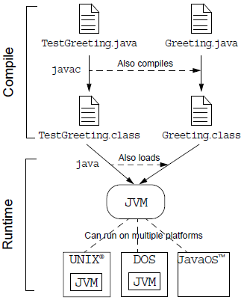
Java Technology Runtime Environment
Notes:
Example objectives
At the end of this lesson, you will be able to:
Save files to the team Web server.
Move files to different locations on the team Web server.
Share files on the team Web server.

Slide 53


